Slide 1

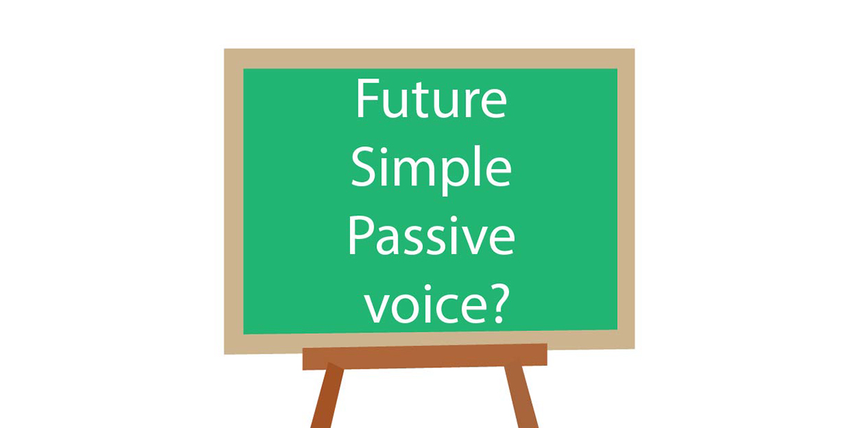

Slide 2

We use Future Simple Passive for actions or events that will happen in future (tomorrow, next week (month, year), in 2020). In such statements we focus attention on the person or thing affected by the action, when the subject is unknown, unclear or irrelevant.
The company will build the bridge next year. – The bridge will be built next year.
They will publish the book next year. – The book will be published next year.
Millions of people will visit the museum. – The museum will be visited by millions of people
He ate all of the cookies.
(Comió todas las galletas.)
All of the cookies were eaten.
(Todas las galletas fueron comidas.)

Slide 3
NO OBJECT
NO PASSIVE
If the sentence in the active voice consists of an object, we can change it into the passive.
This sentences has no Object.
Remember the object is what or who receives the action
She will come tomorrow.
The direct object of this sentence is “building” (what wil they destroy?) so we CAN change it to passive voice.
They will destroy the building next year
The building will be destroyed next year by them.

Slide 4
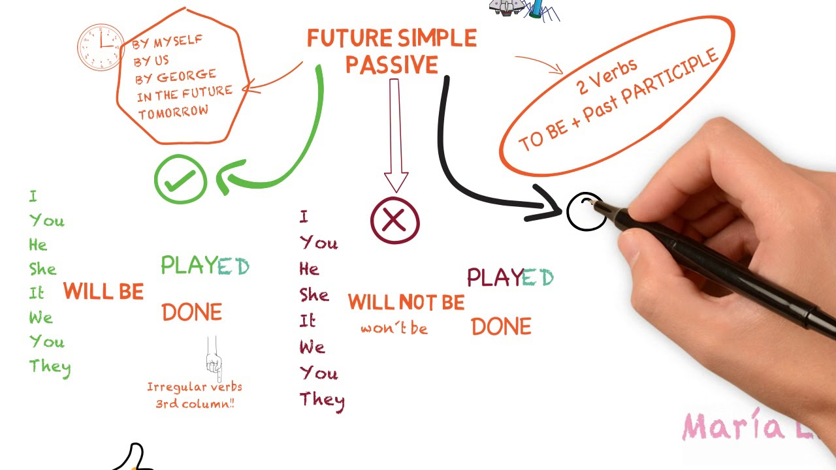

Slide 5
Structure for
POSITIVE
Object
WILL BE
Verb in past participle
Complement
English will be spoken at the conference.
The new university will be opened by the President.
The documents will all be signed by next week.

Slide 6
Structure for
NEGATIVE
Object
WILL NOT BE
Verb in past participle
Complement
The chickens will not be fed at night.
The old machine will not be replaced this week.
Your package will not be delivered later today.
Classes will not be given in Spanish.

Slide 7
Structure for
QUESTIONS
WILL
Object
BE
Verb in past participle
Complement
Will Jane be visited by her relatives from New York?
Will the room be cleaned tomorrow?
Will the contract be signed by the manager tomorrow?

Slide 8
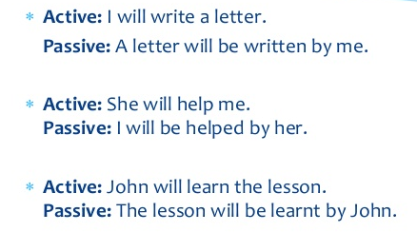

Slide 9

LET’S
PRACTICE!

Slide 10
Active Voice
Passive Voice
1
Jane will buy a new computer.
A new computer will be bought by Jane
2
Millions of people will visit the museum.
The museum will be visited by millions of people
3
He won't see Sue
Sue won’t be seen by him.
4
Her boyfriend will install it.
It will be installed by her boyfriend
5
You will not do it.
It will not be done by you.
6
They will not show the new film.
The new film will not be shown by them.

Slide 11
Active Voice
Passive Voice
1
They will not ask him.
He will not be asked by them.
2
Will the company employ a new worker?
Will a new worker be employed by the company?
3
Will the plumber repair the shower?
Will the shower be repaired by the plumber?
4
John will learn the lesson.
The lesson will be learnt by John.
5
Will they accept our invitation?
Will our invitation be accepted by them?
6
We shall not betray our country.
Our country shall not be betrayed by us.

Slide 12
Sources
https://grammartop.com/the-future-simple-passive/#:~:text=Future%20Simple%20Passive%20is%20used,will%20be%20done%20on%20time.
https://www.youtube.com/watch?v=W1_IRU6zx9g (active vs passive)
https://www.englishreservoir.com/es/gramatica-esencial/todas-formas-pasivas/futuro-simple/ (Why use passive voice in future?)
https://www.ego4u.com/en/cram-up/grammar/passive/exercises?future-1 (exercise examples)
https://www.youtube.com/watch?v=QWzLZoIxrac (explanation of future passive in Spanish)
https://www.youtube.com/watch?v=eZdyYbP-f4A&t=169s
https://www.youtube.com/watch?v=jb0xZL9vPqY (passive and active voice)
https://www.englisch-hilfen.de/en/exercises/active_passive/sentences_will_future.htm (online exercise)
https://es.liveworksheets.com/worksheets/en/English_language/Passive_voice/Passive_Voice-_Future_Simple_yb29576ic (activity #1 exercise)
https://www.spanishdict.com/answers/136842/lets-play-with-active-an-passive-voice-simple-future-tense (many examples in English and Spanish, active to passive)
https://avi.cuaed.unam.mx/repositorio/moodle/pluginfile.php/2670/mod_resource/content/2/contenido/index.html (Reading and identifying practice for class)

